Slide 1
Deep Learning in Image Processing
Topics:
Image Filtering 101
CNNs 101
Image Processing Pipelines
Frank Dellaert
CS 4476 Computer Vision
Many slides from Stanford’s CS231N by Fei-Fei Li, Justin Johnson, Serena Yeung, as well as some slides on filtering from Devi Parikh and Kristen Grauman, who may in turn have borrowed some from others

Slide 2
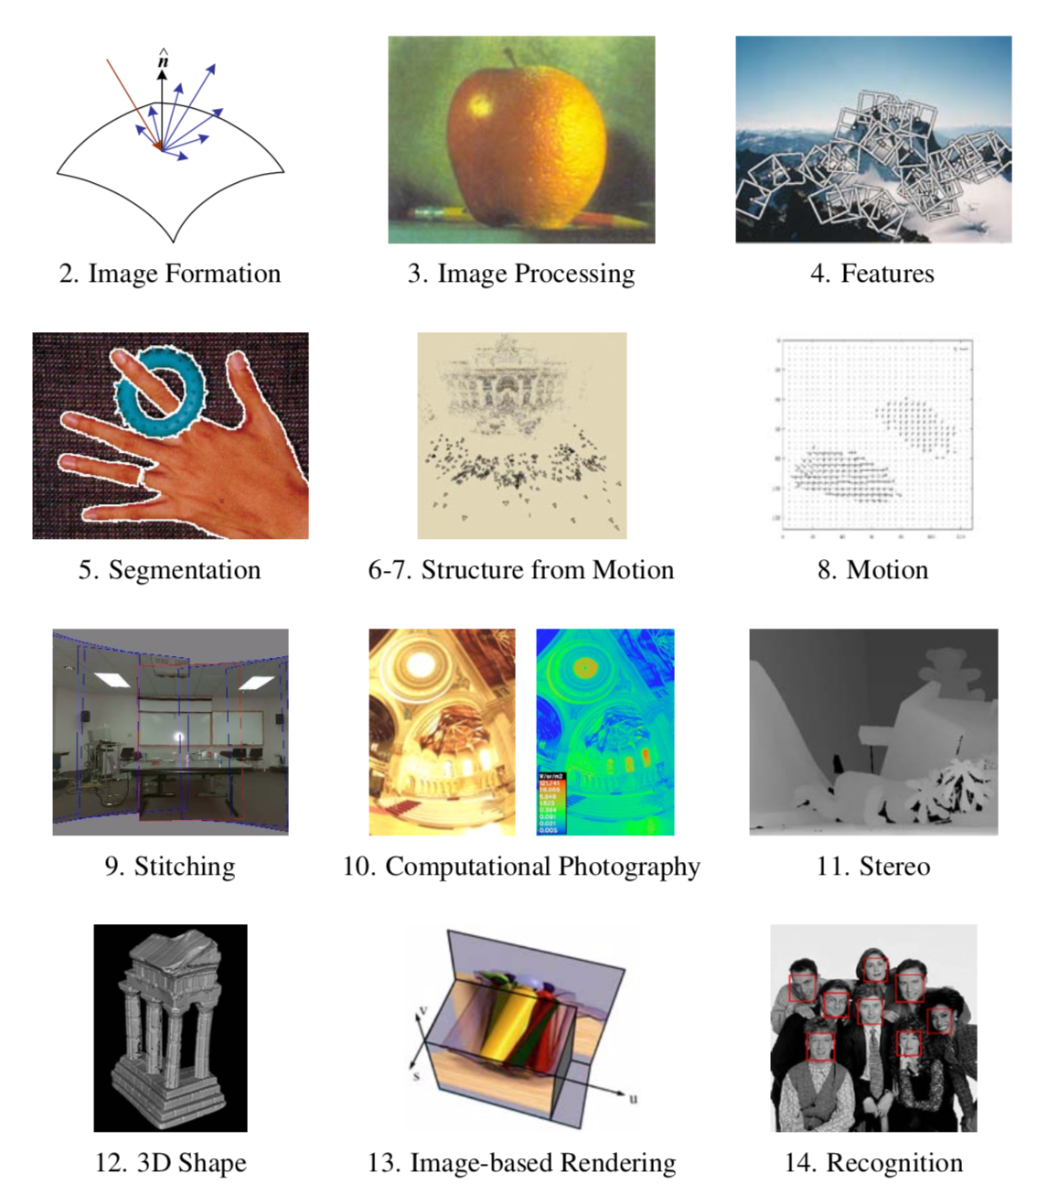

Slide 3
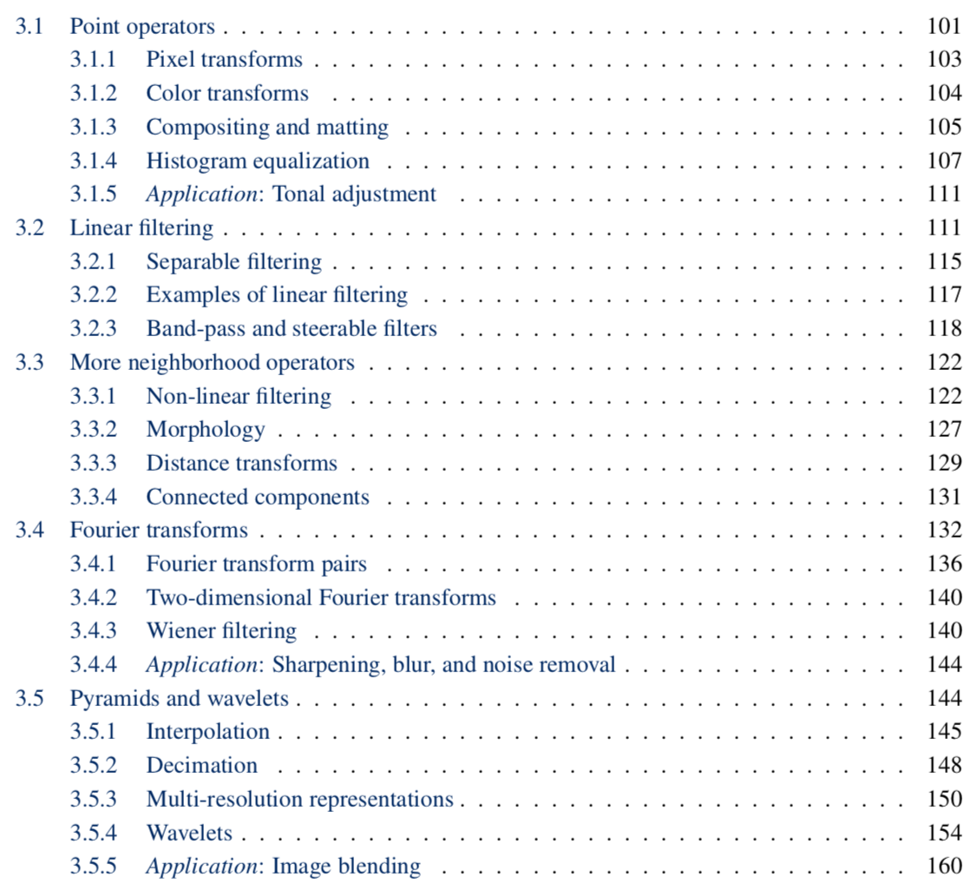

Slide 4
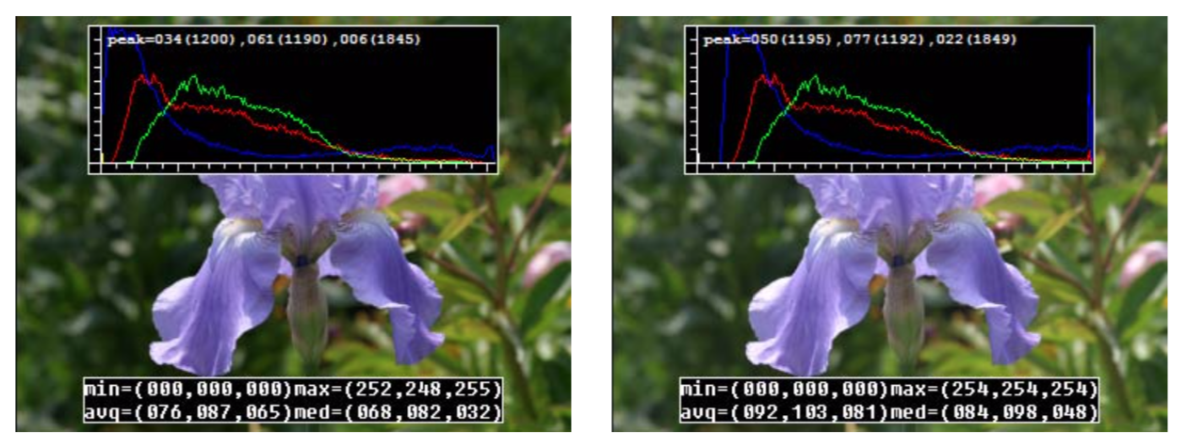
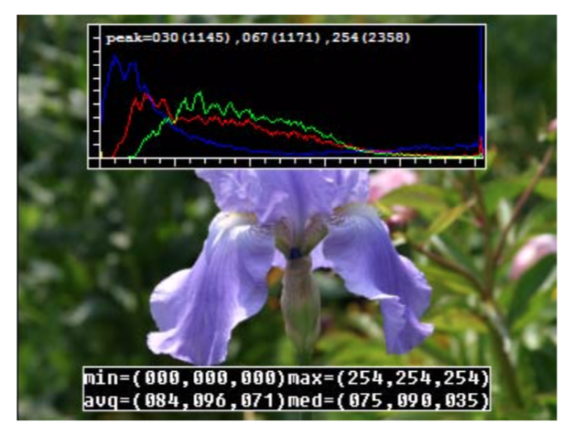
Contrast
g(x) = a f(x), a=1.1

Slide 5
Brightness
g(x) = f(x) + b, b=16

Slide 7
Image filtering
Compute a function of the local neighborhood at each pixel in the image
Function specified by a “filter” or mask saying how to combine values from neighbors.
Uses of filtering:
Enhance an image (denoise, resize, etc)
Extract information (texture, edges, etc)
Detect patterns (template matching)
Slide credit: Kristen Grauman, Adapted from Derek Hoiem

Slide 8
Image filtering
Compute a function of the local neighborhood at each pixel in the image
Function specified by a “filter” or mask saying how to combine values from neighbors.
Uses of filtering:
Enhance an image (denoise, resize, etc)
Extract information (texture, edges, etc)
Detect patterns (template matching)
Slide credit: Kristen Grauman, Adapted from Derek Hoiem

Slide 9
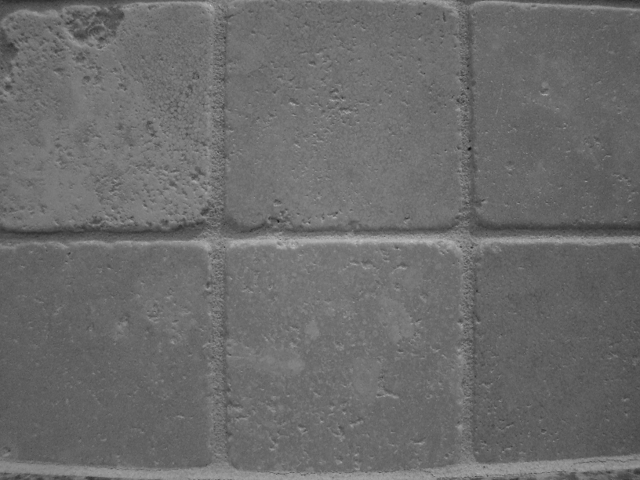
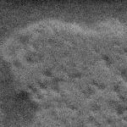

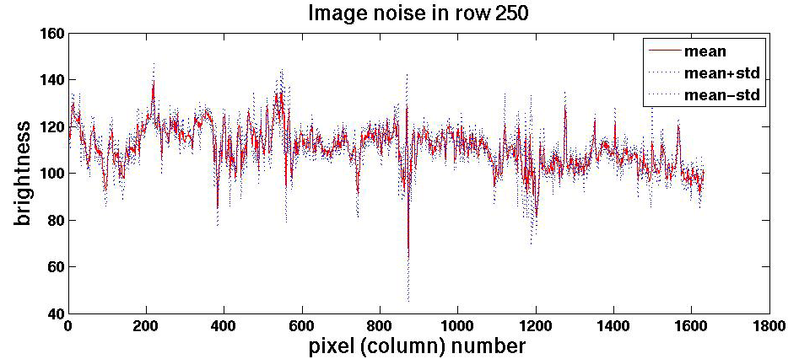
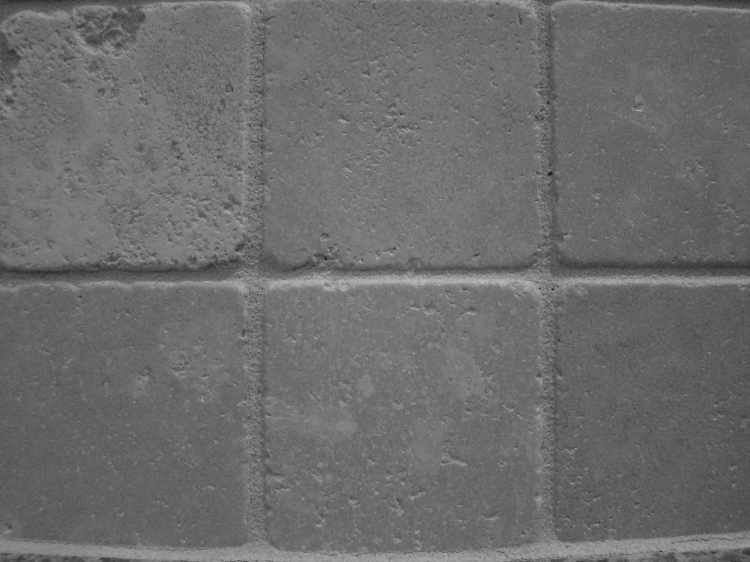
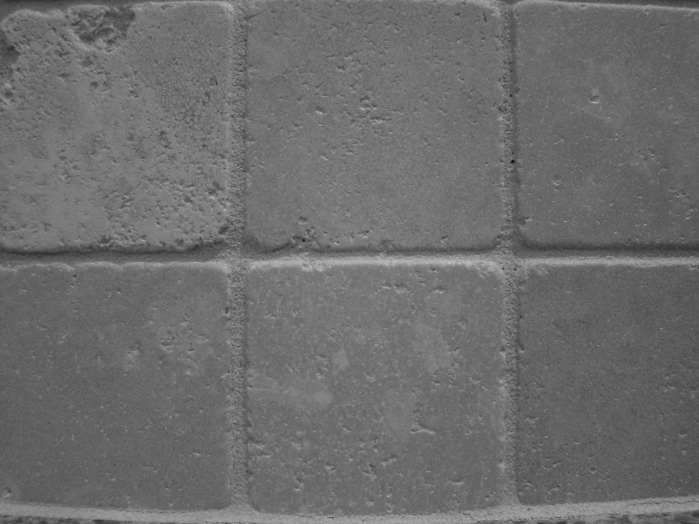


Motivation: noise reduction
Even multiple images of the same static scene will not be identical.
Slide credit: Adapted from Kristen Grauman

Slide 10
Common types of noise
Salt and pepper noise: random occurrences of black and white pixels
Impulse noise: random occurrences of white pixels
Gaussian noise: variations in intensity drawn from a Gaussian normal distribution
Slide credit: Steve Seitz

Slide 11
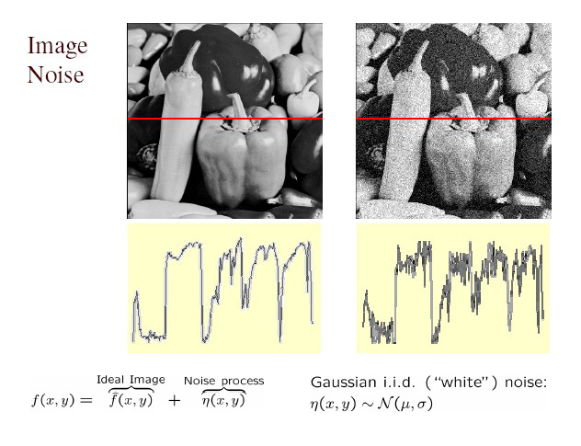
Gaussian noise
>> noise = randn(size(im)).*sigma;
>> output = im + noise;
Slide credit: Kristen Grauman
Figure from Martial Hebert
What is impact of the sigma?

Slide 12
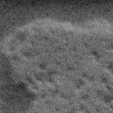
Motivation: noise reduction
Even multiple images of the same static scene will not be identical.
How could we reduce the noise, i.e., give an estimate of the true intensities?
What if there’s only one image?
Slide credit: Kristen Grauman

Slide 13
First attempt at a solution
Let’s replace each pixel with an average of all the values in its neighborhood
Assumptions:
Expect pixels to be like their neighbors
Expect noise processes to be independent from pixel to pixel
Slide credit: Kristen Grauman

Slide 14
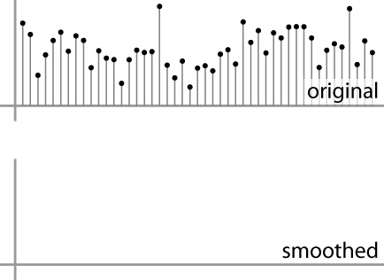
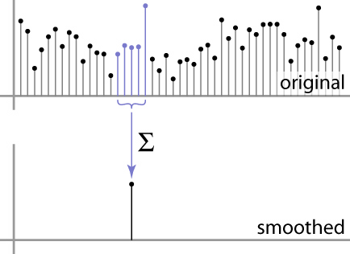
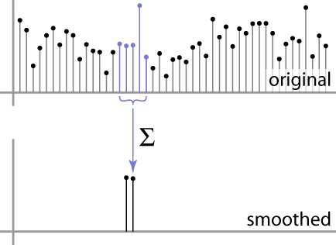
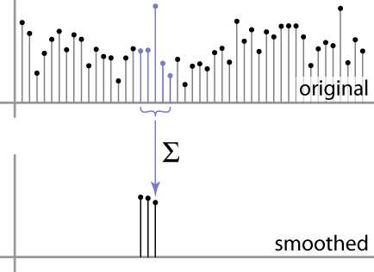
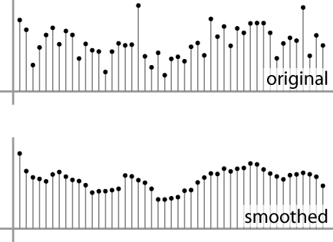
First attempt at a solution
Let’s replace each pixel with an average of all the values in its neighborhood
Moving average in 1D:
Slide credit: S. Marschner

Slide 15
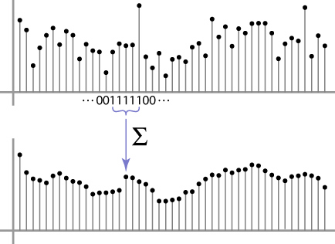
Weighted Moving Average
Can add weights to our moving average
Weights [1, 1, 1, 1, 1] / 5
Slide credit: S. Marschner

Slide 16

Weighted Moving Average
Non-uniform weights [1, 4, 6, 4, 1] / 16
Slide credit: S. Marschner

Slide 17
Image filtering
Image filtering: compute function of local neighborhood at each position
Really important!
Enhance images
Denoise, resize, increase contrast, etc.
Extract information from images
Texture, edges, distinctive points, etc.
Detect patterns
Template matching
Deep Convolutional Networks

Slide 18
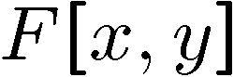
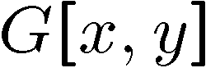
Moving Average In 2D
0 | 0 | 0 | 0 | 0 | 0 | 0 | 0 | 0 | 0
0 | 0 | 0 | 0 | 0 | 0 | 0 | 0 | 0 | 0
0 | 0 | 0 | 90 | 90 | 90 | 90 | 90 | 0 | 0
0 | 0 | 0 | 90 | 90 | 90 | 90 | 90 | 0 | 0
0 | 0 | 0 | 90 | 90 | 90 | 90 | 90 | 0 | 0
0 | 0 | 0 | 90 | 0 | 90 | 90 | 90 | 0 | 0
0 | 0 | 0 | 90 | 90 | 90 | 90 | 90 | 0 | 0
0 | 0 | 0 | 0 | 0 | 0 | 0 | 0 | 0 | 0
0 | 0 | 90 | 0 | 0 | 0 | 0 | 0 | 0 | 0
0 | 0 | 0 | 0 | 0 | 0 | 0 | 0 | 0 | 0
0 | 0 | 0 | 0 | 0 | 0 | 0 | 0 | 0 | 0
0 | 0 | 0 | 0 | 0 | 0 | 0 | 0 | 0 | 0
0 | 0 | 0 | 90 | 90 | 90 | 90 | 90 | 0 | 0
0 | 0 | 0 | 90 | 90 | 90 | 90 | 90 | 0 | 0
0 | 0 | 0 | 90 | 90 | 90 | 90 | 90 | 0 | 0
0 | 0 | 0 | 90 | 0 | 90 | 90 | 90 | 0 | 0
0 | 0 | 0 | 90 | 90 | 90 | 90 | 90 | 0 | 0
0 | 0 | 0 | 0 | 0 | 0 | 0 | 0 | 0 | 0
0 | 0 | 90 | 0 | 0 | 0 | 0 | 0 | 0 | 0
0 | 0 | 0 | 0 | 0 | 0 | 0 | 0 | 0 | 0
Slide credit: Steve Seitz

Slide 19
Moving Average In 2D
0 | 0 | 0 | 0 | 0 | 0 | 0 | 0 | 0 | 0
0 | 0 | 0 | 0 | 0 | 0 | 0 | 0 | 0 | 0
0 | 0 | 0 | 90 | 90 | 90 | 90 | 90 | 0 | 0
0 | 0 | 0 | 90 | 90 | 90 | 90 | 90 | 0 | 0
0 | 0 | 0 | 90 | 90 | 90 | 90 | 90 | 0 | 0
0 | 0 | 0 | 90 | 0 | 90 | 90 | 90 | 0 | 0
0 | 0 | 0 | 90 | 90 | 90 | 90 | 90 | 0 | 0
0 | 0 | 0 | 0 | 0 | 0 | 0 | 0 | 0 | 0
0 | 0 | 90 | 0 | 0 | 0 | 0 | 0 | 0 | 0
0 | 0 | 0 | 0 | 0 | 0 | 0 | 0 | 0 | 0
 | 0
0 | 0 | 0 | 0 | 0 | 0 | 0 | 0 | 0 | 0
0 | 0 | 0 | 0 | 0 | 0 | 0 | 0 | 0 | 0
0 | 0 | 0 | 90 | 90 | 90 | 90 | 90 | 0 | 0
0 | 0 | 0 | 90 | 90 | 90 | 90 | 90 | 0 | 0
0 | 0 | 0 | 90 | 90 | 90 | 90 | 90 | 0 | 0
0 | 0 | 0 | 90 | 0 | 90 | 90 | 90 | 0 | 0
0 | 0 | 0 | 90 | 90 | 90 | 90 | 90 | 0 | 0
0 | 0 | 0 | 0 | 0 | 0 | 0 | 0 | 0 | 0
0 | 0 | 90 | 0 | 0 | 0 | 0 | 0 | 0 | 0
0 | 0 | 0 | 0 | 0 | 0 | 0 | 0 | 0 | 0
Slide credit: Steve Seitz

Slide 20
Moving Average In 2D
0 | 0 | 0 | 0 | 0 | 0 | 0 | 0 | 0 | 0
0 | 0 | 0 | 0 | 0 | 0 | 0 | 0 | 0 | 0
0 | 0 | 0 | 90 | 90 | 90 | 90 | 90 | 0 | 0
0 | 0 | 0 | 90 | 90 | 90 | 90 | 90 | 0 | 0
0 | 0 | 0 | 90 | 90 | 90 | 90 | 90 | 0 | 0
0 | 0 | 0 | 90 | 0 | 90 | 90 | 90 | 0 | 0
0 | 0 | 0 | 90 | 90 | 90 | 90 | 90 | 0 | 0
0 | 0 | 0 | 0 | 0 | 0 | 0 | 0 | 0 | 0
0 | 0 | 90 | 0 | 0 | 0 | 0 | 0 | 0 | 0
0 | 0 | 0 | 0 | 0 | 0 | 0 | 0 | 0 | 0
 | 0
0 | 0 | 0 | 0 | 0 | 0 | 0 | 0 | 0 | 0
0 | 0 | 0 | 0 | 0 | 0 | 0 | 0 | 0 | 0
0 | 0 | 0 | 90 | 90 | 90 | 90 | 90 | 0 | 0
0 | 0 | 0 | 90 | 90 | 90 | 90 | 90 | 0 | 0
0 | 0 | 0 | 90 | 90 | 90 | 90 | 90 | 0 | 0
0 | 0 | 0 | 90 | 0 | 90 | 90 | 90 | 0 | 0
0 | 0 | 0 | 90 | 90 | 90 | 90 | 90 | 0 | 0
0 | 0 | 0 | 0 | 0 | 0 | 0 | 0 | 0 | 0
0 | 0 | 90 | 0 | 0 | 0 | 0 | 0 | 0 | 0
0 | 0 | 0 | 0 | 0 | 0 | 0 | 0 | 0 | 0
Slide credit: Steve Seitz

Slide 21
Moving Average In 2D
0 | 0 | 0 | 0 | 0 | 0 | 0 | 0 | 0 | 0
0 | 0 | 0 | 0 | 0 | 0 | 0 | 0 | 0 | 0
0 | 0 | 0 | 90 | 90 | 90 | 90 | 90 | 0 | 0
0 | 0 | 0 | 90 | 90 | 90 | 90 | 90 | 0 | 0
0 | 0 | 0 | 90 | 90 | 90 | 90 | 90 | 0 | 0
0 | 0 | 0 | 90 | 0 | 90 | 90 | 90 | 0 | 0
0 | 0 | 0 | 90 | 90 | 90 | 90 | 90 | 0 | 0
0 | 0 | 0 | 0 | 0 | 0 | 0 | 0 | 0 | 0
0 | 0 | 90 | 0 | 0 | 0 | 0 | 0 | 0 | 0
0 | 0 | 0 | 0 | 0 | 0 | 0 | 0 | 0 | 0
 | 0 | 10
0 | 0 | 0 | 0 | 0 | 0 | 0 | 0 | 0 | 0
0 | 0 | 0 | 0 | 0 | 0 | 0 | 0 | 0 | 0
0 | 0 | 0 | 90 | 90 | 90 | 90 | 90 | 0 | 0
0 | 0 | 0 | 90 | 90 | 90 | 90 | 90 | 0 | 0
0 | 0 | 0 | 90 | 90 | 90 | 90 | 90 | 0 | 0
0 | 0 | 0 | 90 | 0 | 90 | 90 | 90 | 0 | 0
0 | 0 | 0 | 90 | 90 | 90 | 90 | 90 | 0 | 0
0 | 0 | 0 | 0 | 0 | 0 | 0 | 0 | 0 | 0
0 | 0 | 90 | 0 | 0 | 0 | 0 | 0 | 0 | 0
0 | 0 | 0 | 0 | 0 | 0 | 0 | 0 | 0 | 0
Slide credit: Steve Seitz

Slide 22
Moving Average In 2D
0 | 0 | 0 | 0 | 0 | 0 | 0 | 0 | 0 | 0
0 | 0 | 0 | 0 | 0 | 0 | 0 | 0 | 0 | 0
0 | 0 | 0 | 90 | 90 | 90 | 90 | 90 | 0 | 0
0 | 0 | 0 | 90 | 90 | 90 | 90 | 90 | 0 | 0
0 | 0 | 0 | 90 | 90 | 90 | 90 | 90 | 0 | 0
0 | 0 | 0 | 90 | 0 | 90 | 90 | 90 | 0 | 0
0 | 0 | 0 | 90 | 90 | 90 | 90 | 90 | 0 | 0
0 | 0 | 0 | 0 | 0 | 0 | 0 | 0 | 0 | 0
0 | 0 | 90 | 0 | 0 | 0 | 0 | 0 | 0 | 0
0 | 0 | 0 | 0 | 0 | 0 | 0 | 0 | 0 | 0
 | 0 | 10
0 | 0 | 0 | 0 | 0 | 0 | 0 | 0 | 0 | 0
0 | 0 | 0 | 0 | 0 | 0 | 0 | 0 | 0 | 0
0 | 0 | 0 | 90 | 90 | 90 | 90 | 90 | 0 | 0
0 | 0 | 0 | 90 | 90 | 90 | 90 | 90 | 0 | 0
0 | 0 | 0 | 90 | 90 | 90 | 90 | 90 | 0 | 0
0 | 0 | 0 | 90 | 0 | 90 | 90 | 90 | 0 | 0
0 | 0 | 0 | 90 | 90 | 90 | 90 | 90 | 0 | 0
0 | 0 | 0 | 0 | 0 | 0 | 0 | 0 | 0 | 0
0 | 0 | 90 | 0 | 0 | 0 | 0 | 0 | 0 | 0
0 | 0 | 0 | 0 | 0 | 0 | 0 | 0 | 0 | 0
Slide credit: Steve Seitz

Slide 23
Moving Average In 2D
0 | 0 | 0 | 0 | 0 | 0 | 0 | 0 | 0 | 0
0 | 0 | 0 | 0 | 0 | 0 | 0 | 0 | 0 | 0
0 | 0 | 0 | 90 | 90 | 90 | 90 | 90 | 0 | 0
0 | 0 | 0 | 90 | 90 | 90 | 90 | 90 | 0 | 0
0 | 0 | 0 | 90 | 90 | 90 | 90 | 90 | 0 | 0
0 | 0 | 0 | 90 | 0 | 90 | 90 | 90 | 0 | 0
0 | 0 | 0 | 90 | 90 | 90 | 90 | 90 | 0 | 0
0 | 0 | 0 | 0 | 0 | 0 | 0 | 0 | 0 | 0
0 | 0 | 90 | 0 | 0 | 0 | 0 | 0 | 0 | 0
0 | 0 | 0 | 0 | 0 | 0 | 0 | 0 | 0 | 0
 | 0 | 10 | 20
0 | 0 | 0 | 0 | 0 | 0 | 0 | 0 | 0 | 0
0 | 0 | 0 | 0 | 0 | 0 | 0 | 0 | 0 | 0
0 | 0 | 0 | 90 | 90 | 90 | 90 | 90 | 0 | 0
0 | 0 | 0 | 90 | 90 | 90 | 90 | 90 | 0 | 0
0 | 0 | 0 | 90 | 90 | 90 | 90 | 90 | 0 | 0
0 | 0 | 0 | 90 | 0 | 90 | 90 | 90 | 0 | 0
0 | 0 | 0 | 90 | 90 | 90 | 90 | 90 | 0 | 0
0 | 0 | 0 | 0 | 0 | 0 | 0 | 0 | 0 | 0
0 | 0 | 90 | 0 | 0 | 0 | 0 | 0 | 0 | 0
0 | 0 | 0 | 0 | 0 | 0 | 0 | 0 | 0 | 0
Slide credit: Steve Seitz

Slide 24
Moving Average In 2D
0 | 0 | 0 | 0 | 0 | 0 | 0 | 0 | 0 | 0
0 | 0 | 0 | 0 | 0 | 0 | 0 | 0 | 0 | 0
0 | 0 | 0 | 90 | 90 | 90 | 90 | 90 | 0 | 0
0 | 0 | 0 | 90 | 90 | 90 | 90 | 90 | 0 | 0
0 | 0 | 0 | 90 | 90 | 90 | 90 | 90 | 0 | 0
0 | 0 | 0 | 90 | 0 | 90 | 90 | 90 | 0 | 0
0 | 0 | 0 | 90 | 90 | 90 | 90 | 90 | 0 | 0
0 | 0 | 0 | 0 | 0 | 0 | 0 | 0 | 0 | 0
0 | 0 | 90 | 0 | 0 | 0 | 0 | 0 | 0 | 0
0 | 0 | 0 | 0 | 0 | 0 | 0 | 0 | 0 | 0
 | 0 | 10 | 20
0 | 0 | 0 | 0 | 0 | 0 | 0 | 0 | 0 | 0
0 | 0 | 0 | 0 | 0 | 0 | 0 | 0 | 0 | 0
0 | 0 | 0 | 90 | 90 | 90 | 90 | 90 | 0 | 0
0 | 0 | 0 | 90 | 90 | 90 | 90 | 90 | 0 | 0
0 | 0 | 0 | 90 | 90 | 90 | 90 | 90 | 0 | 0
0 | 0 | 0 | 90 | 0 | 90 | 90 | 90 | 0 | 0
0 | 0 | 0 | 90 | 90 | 90 | 90 | 90 | 0 | 0
0 | 0 | 0 | 0 | 0 | 0 | 0 | 0 | 0 | 0
0 | 0 | 90 | 0 | 0 | 0 | 0 | 0 | 0 | 0
0 | 0 | 0 | 0 | 0 | 0 | 0 | 0 | 0 | 0
Slide credit: Steve Seitz

Slide 25
Moving Average In 2D
0 | 0 | 0 | 0 | 0 | 0 | 0 | 0 | 0 | 0
0 | 0 | 0 | 0 | 0 | 0 | 0 | 0 | 0 | 0
0 | 0 | 0 | 90 | 90 | 90 | 90 | 90 | 0 | 0
0 | 0 | 0 | 90 | 90 | 90 | 90 | 90 | 0 | 0
0 | 0 | 0 | 90 | 90 | 90 | 90 | 90 | 0 | 0
0 | 0 | 0 | 90 | 0 | 90 | 90 | 90 | 0 | 0
0 | 0 | 0 | 90 | 90 | 90 | 90 | 90 | 0 | 0
0 | 0 | 0 | 0 | 0 | 0 | 0 | 0 | 0 | 0
0 | 0 | 90 | 0 | 0 | 0 | 0 | 0 | 0 | 0
0 | 0 | 0 | 0 | 0 | 0 | 0 | 0 | 0 | 0
 | 0 | 10 | 20 | 30
0 | 0 | 0 | 0 | 0 | 0 | 0 | 0 | 0 | 0
0 | 0 | 0 | 0 | 0 | 0 | 0 | 0 | 0 | 0
0 | 0 | 0 | 90 | 90 | 90 | 90 | 90 | 0 | 0
0 | 0 | 0 | 90 | 90 | 90 | 90 | 90 | 0 | 0
0 | 0 | 0 | 90 | 90 | 90 | 90 | 90 | 0 | 0
0 | 0 | 0 | 90 | 0 | 90 | 90 | 90 | 0 | 0
0 | 0 | 0 | 90 | 90 | 90 | 90 | 90 | 0 | 0
0 | 0 | 0 | 0 | 0 | 0 | 0 | 0 | 0 | 0
0 | 0 | 90 | 0 | 0 | 0 | 0 | 0 | 0 | 0
0 | 0 | 0 | 0 | 0 | 0 | 0 | 0 | 0 | 0
Slide credit: Steve Seitz

Slide 26
Moving Average In 2D
0 | 0 | 0 | 0 | 0 | 0 | 0 | 0 | 0 | 0
0 | 0 | 0 | 0 | 0 | 0 | 0 | 0 | 0 | 0
0 | 0 | 0 | 90 | 90 | 90 | 90 | 90 | 0 | 0
0 | 0 | 0 | 90 | 90 | 90 | 90 | 90 | 0 | 0
0 | 0 | 0 | 90 | 90 | 90 | 90 | 90 | 0 | 0
0 | 0 | 0 | 90 | 0 | 90 | 90 | 90 | 0 | 0
0 | 0 | 0 | 90 | 90 | 90 | 90 | 90 | 0 | 0
0 | 0 | 0 | 0 | 0 | 0 | 0 | 0 | 0 | 0
0 | 0 | 90 | 0 | 0 | 0 | 0 | 0 | 0 | 0
0 | 0 | 0 | 0 | 0 | 0 | 0 | 0 | 0 | 0
 | 0 | 10 | 20 | 30
Slide credit: Steve Seitz

Slide 27
Moving Average In 2D
0 | 0 | 0 | 0 | 0 | 0 | 0 | 0 | 0 | 0
0 | 0 | 0 | 0 | 0 | 0 | 0 | 0 | 0 | 0
0 | 0 | 0 | 90 | 90 | 90 | 90 | 90 | 0 | 0
0 | 0 | 0 | 90 | 90 | 90 | 90 | 90 | 0 | 0
0 | 0 | 0 | 90 | 90 | 90 | 90 | 90 | 0 | 0
0 | 0 | 0 | 90 | 0 | 90 | 90 | 90 | 0 | 0
0 | 0 | 0 | 90 | 90 | 90 | 90 | 90 | 0 | 0
0 | 0 | 0 | 0 | 0 | 0 | 0 | 0 | 0 | 0
0 | 0 | 90 | 0 | 0 | 0 | 0 | 0 | 0 | 0
0 | 0 | 0 | 0 | 0 | 0 | 0 | 0 | 0 | 0
 | 0 | 10 | 20 | 30 | 30
Slide credit: Steve Seitz

Slide 28
Moving Average In 2D
0 | 0 | 0 | 0 | 0 | 0 | 0 | 0 | 0 | 0
0 | 0 | 0 | 0 | 0 | 0 | 0 | 0 | 0 | 0
0 | 0 | 0 | 90 | 90 | 90 | 90 | 90 | 0 | 0
0 | 0 | 0 | 90 | 90 | 90 | 90 | 90 | 0 | 0
0 | 0 | 0 | 90 | 90 | 90 | 90 | 90 | 0 | 0
0 | 0 | 0 | 90 | 0 | 90 | 90 | 90 | 0 | 0
0 | 0 | 0 | 90 | 90 | 90 | 90 | 90 | 0 | 0
0 | 0 | 0 | 0 | 0 | 0 | 0 | 0 | 0 | 0
0 | 0 | 90 | 0 | 0 | 0 | 0 | 0 | 0 | 0
0 | 0 | 0 | 0 | 0 | 0 | 0 | 0 | 0 | 0
 | 0 | 10 | 20 | 30 | 30 | 30 | 20 | 10
 | 0 | 20 | 40 | 60 | 60 | 60 | 40 | 20
 | 0 | 30 | 60 | 90 | 90 | 90 | 60 | 30
 | 0 | 30 | 50 | 80 | 80 | 90 | 60 | 30
 | 0 | 30 | 50 | 80 | 80 | 90 | 60 | 30
 | 0 | 20 | 30 | 50 | 50 | 60 | 40 | 20
 | 10 | 20 | 30 | 30 | 30 | 30 | 20 | 10
 | 10 | 10 | 10 | 0 | 0 | 0 | 0 | 0
Slide credit: Steve Seitz
Notes:
ones, divide by 9

Slide 29
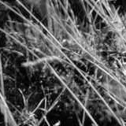
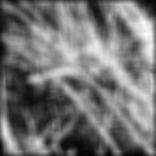
Smoothing with box filter

Slide 30
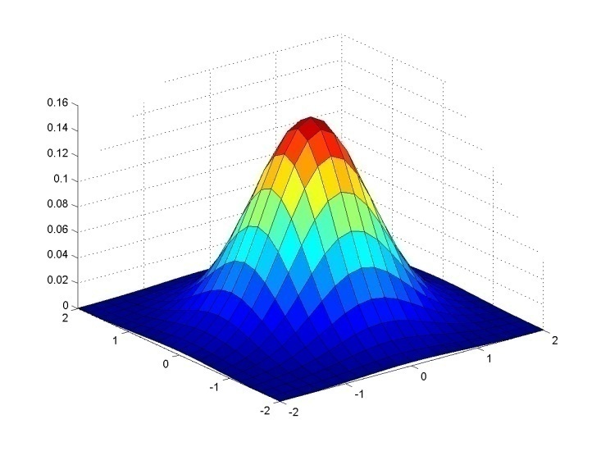
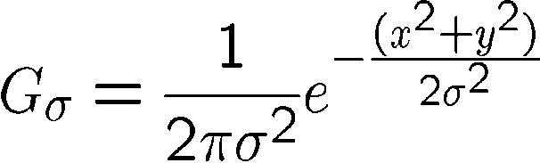
Important filter: Gaussian
Weight contributions of neighboring pixels by nearness
0.003 0.013 0.022 0.013 0.003
0.013 0.059 0.097 0.059 0.013
0.022 0.097 0.159 0.097 0.022
0.013 0.059 0.097 0.059 0.013
0.003 0.013 0.022 0.013 0.003
5 x 5, σ = 1
Slide credit: Christopher Rasmussen
Notes:
e^0 = 1, e^-1 = .37, e^-2 = .14, etc.

Slide 31

Smoothing with Gaussian filter

Slide 32
Smoothing with box filter

Slide 33
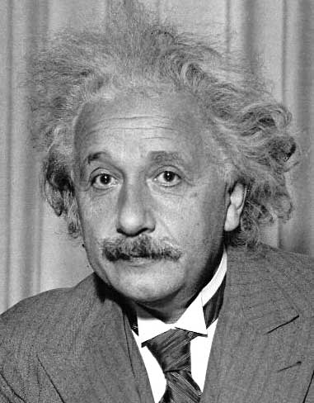
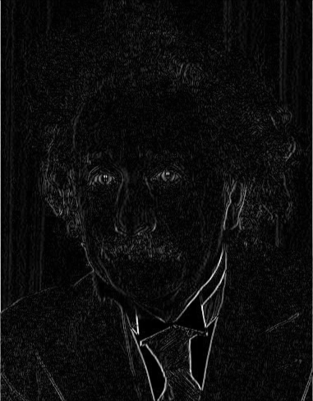
Other filters
1
0
-1
2
0
-2
1
0
-1
Sobel
Vertical Edge
(absolute value)

Slide 34
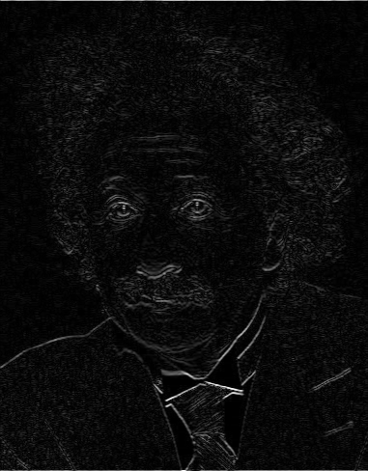
Other filters
1
2
1
0
0
0
-1
-2
-1
Sobel
Horizontal Edge
(absolute value)
Notes:
Questions at this point?

Slide 35
Gaussian filters
Remove “high-frequency” components from the image (low-pass filter)
Images become more smooth
Convolution with self is another Gaussian
So can smooth with small-width kernel, repeat, and get same result as larger-width kernel would have
Convolving two times with Gaussian kernel of width σ is same as convolving once with kernel of width σ√2
Separable kernel
Factors into product of two 1D Gaussians
Source: K. Grauman
Notes:
Linear vs. quadratic in mask size

Slide 36
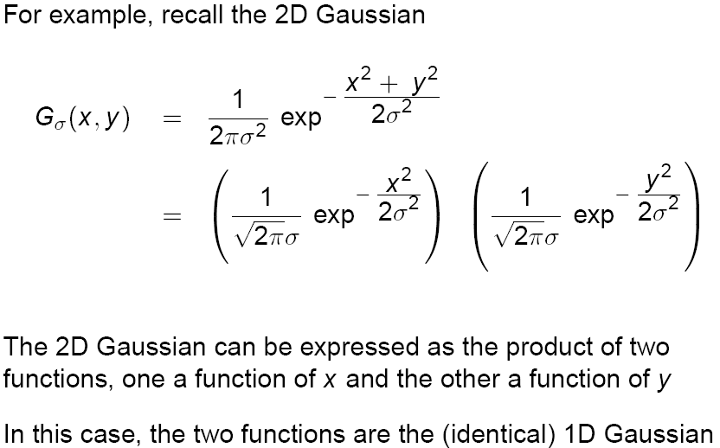
Separability of the Gaussian filter
Source: D. Lowe

Slide 37
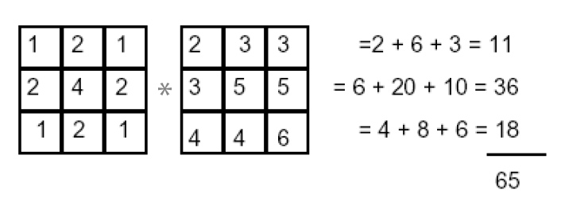
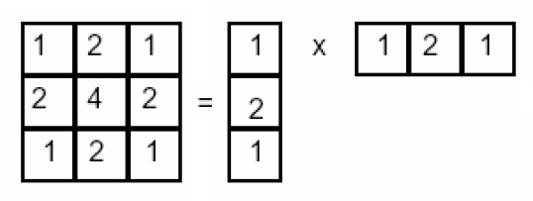
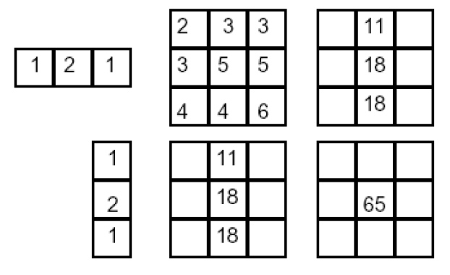
Separability example
2D convolution (center location only)
The filter factors into a product of 1D filters:
Perform convolution along rows:
*
=
Followed by convolution along the remaining column:
*
=
Source: K. Grauman
Notes:
Convolution vs filtering doesn’t matter here because the filter is symmetric

Slide 39
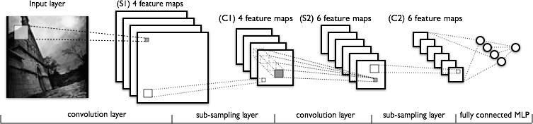
Convolutional Neural Networks
a
Image Credit: Yann LeCun, Kevin Murphy

Slide 40

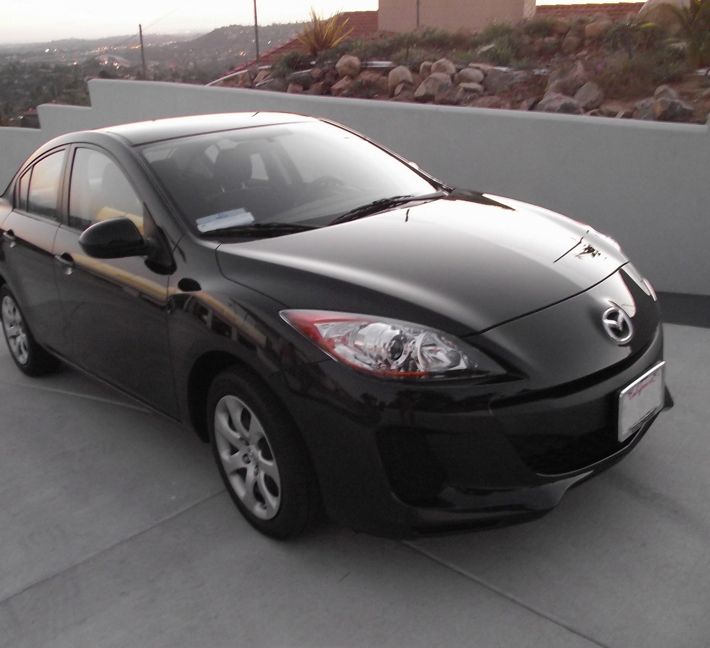
preview:
Slide Credit: Fei-Fei Li, Justin Johnson, Serena Yeung, CS 231n
Notes:
Convnet is stack of layers
Look at how an image progresses through the network, and sizes of output after each layer
Car image is photo taken by Lane McIntosh, permission to use.

Slide 41
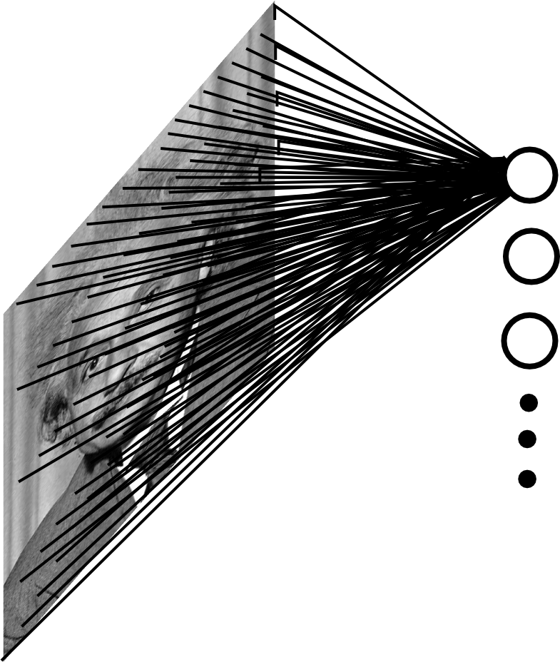
Fully Connected Layer
Example: 200x200 image
40K hidden units
~2B parameters!!!
- Spatial correlation is local
- Waste of resources + we have not enough training samples anyway..
Slide Credit: Marc'Aurelio Ranzato

Slide 42
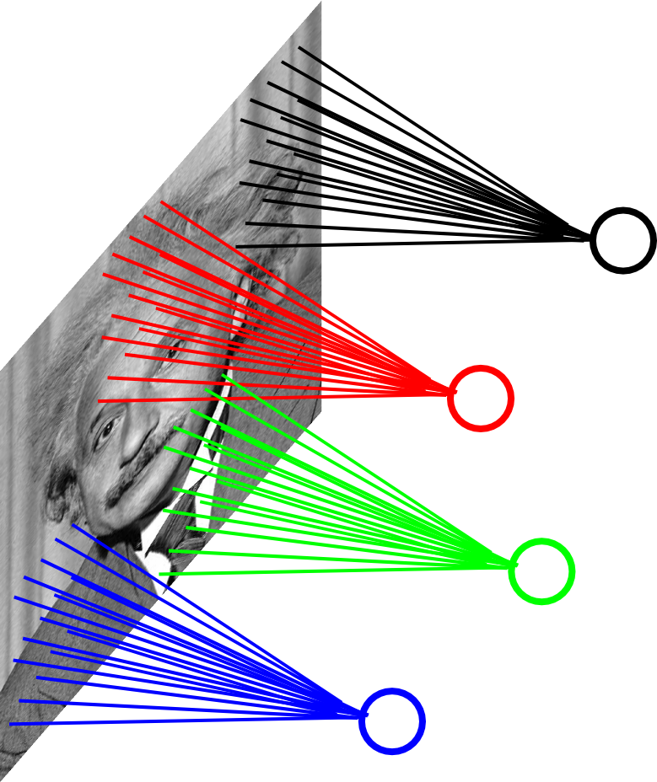
Locally Connected Layer
Example: 200x200 image
40K hidden units
Filter size: 10x10
4M parameters
Note: This parameterization is good when input image is registered (e.g., face recognition).
Slide Credit: Marc'Aurelio Ranzato

Slide 43
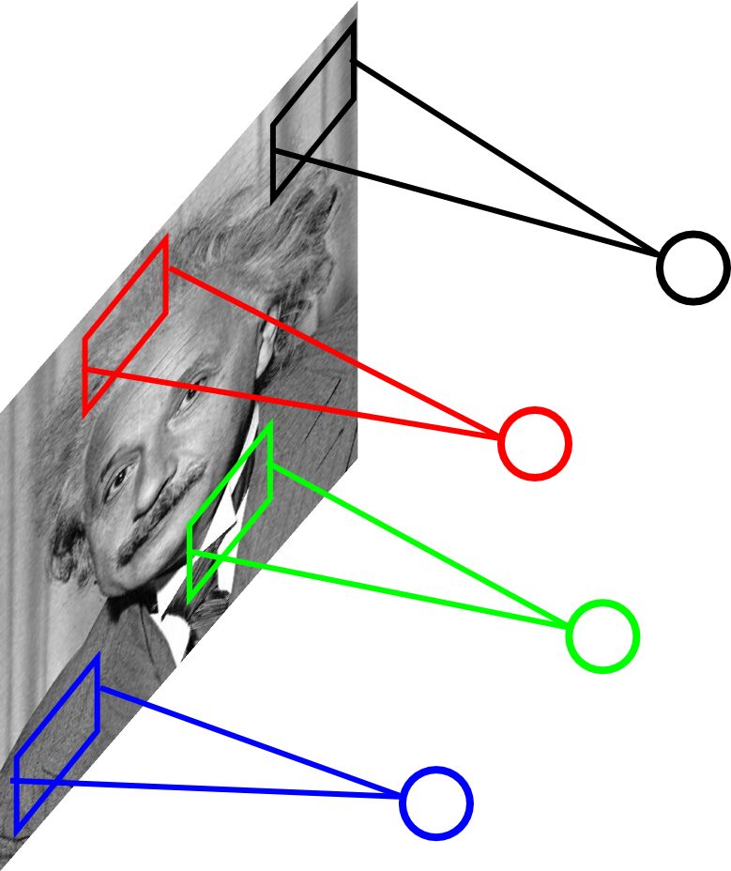
Locally Connected Layer
STATIONARITY? Statistics is similar at different locations
Slide Credit: Marc'Aurelio Ranzato

Slide 44
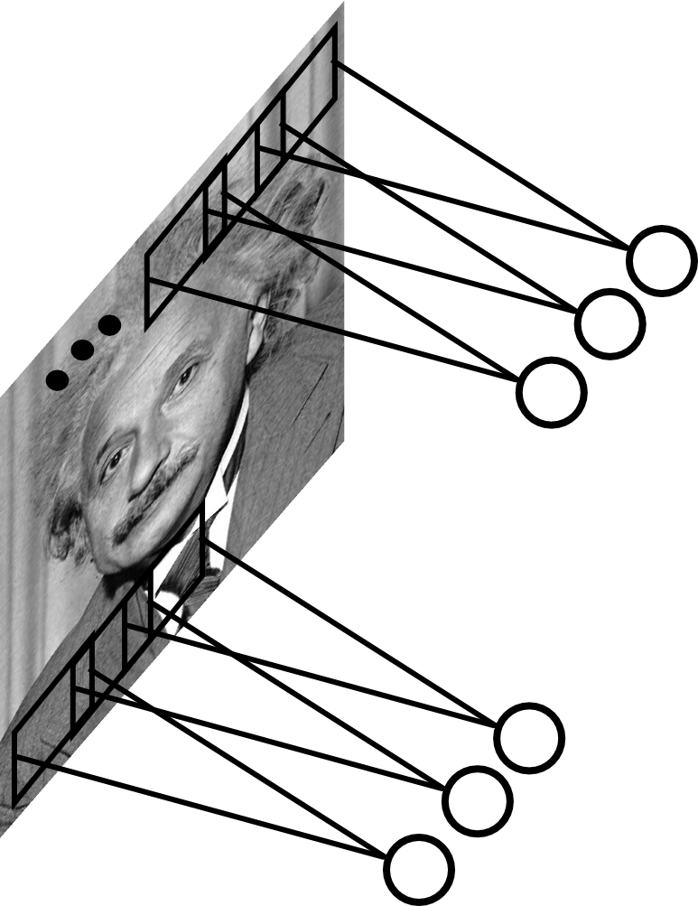
Convolutional Layer
Share the same parameters across different locations (assuming input is stationary):
Convolutions with learned kernels
Slide Credit: Marc'Aurelio Ranzato

Slide 45
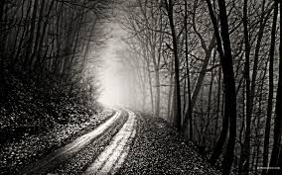
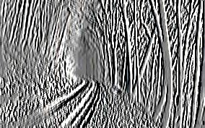
Convolutional Layer
-1 0 1
-1 0 1
-1 0 1
=
*
Slide Credit: Marc'Aurelio Ranzato

Slide 46
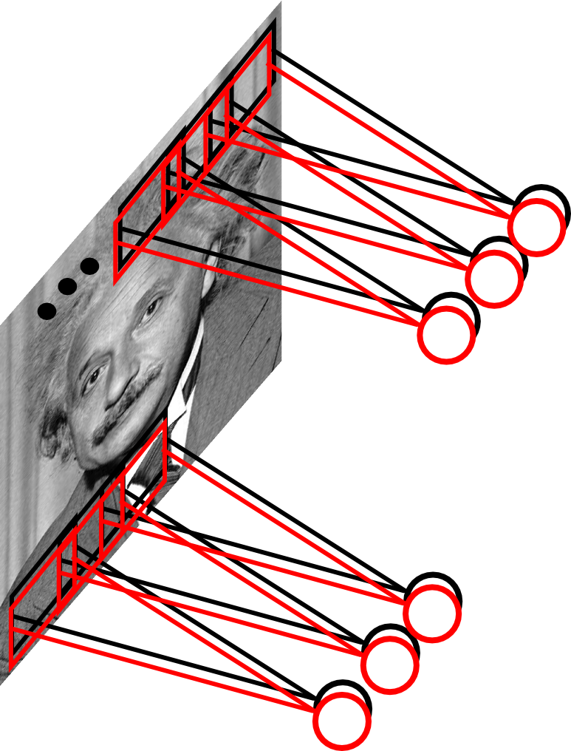
Convolutional Layer
Learn multiple filters.
E.g.: 200x200 image
100 Filters
Filter size: 10x10
10K parameters
Slide Credit: Marc'Aurelio Ranzato

Slide 47
Convolution Layer
32x32x3 image -> preserve spatial structure
32
height
32
width
3
depth
Slide Credit: Fei-Fei Li, Justin Johnson, Serena Yeung, CS 231n
Notes:
Preserve spatial structure of input

Slide 48
Convolution Layer
activation map
32x32x3 image
5x5x3 filter
32
28
convolve (slide) over all spatial locations
32
28
3
1
Slide Credit: Fei-Fei Li, Justin Johnson, Serena Yeung, CS 231n

Slide 49
Multiple filters: if we have 6 5x5 filters, we’ll get 6 separate activation maps:
activation maps
32
28
Convolution Layer
32
28
3
6
We stack these up to get a “new image” of size 28x28x6!
Slide Credit: Fei-Fei Li, Justin Johnson, Serena Yeung, CS 231n

Slide 50
Preview: ConvNet is a sequence of Convolution Layers, interspersed with activation functions
32
28
CONV,
ReLU
e.g. 6 5x5x3 filters
32
28
3
6
Slide Credit: Fei-Fei Li, Justin Johnson, Serena Yeung, CS 231n

Slide 51
Preview: ConvNet is a sequence of Convolutional Layers, interspersed with activation functions
32
28
24
….
CONV,
ReLU
e.g. 6 5x5x3 filters
CONV,
ReLU
e.g. 10 5x5x6 filters
CONV,
ReLU
32
28
24
3
6
10
Slide Credit: Fei-Fei Li, Justin Johnson, Serena Yeung, CS 231n

Slide 52
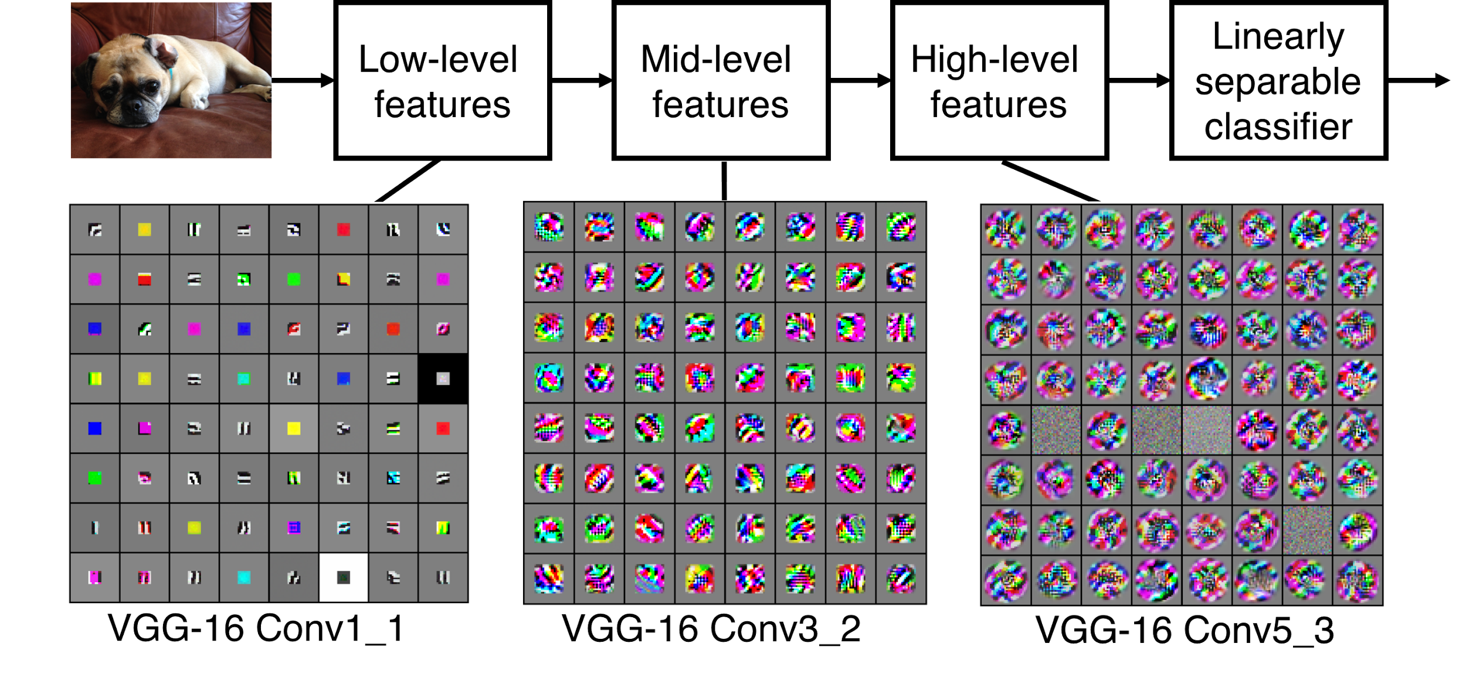
Preview
[Zeiler and Fergus 2013]
Visualization of VGG-16 by Lane McIntosh. VGG-16 architecture from [Simonyan and Zisserman 2014].
Slide Credit: Fei-Fei Li, Justin Johnson, Serena Yeung, CS 231n
Notes:
Each layer has many filters each producing an activation map
what ends up learning is hierarchy of filters, talk more in depth later
In this visualization [Lane] maximized the activity of a central cluster of units from the same filter type in various VGG-16 layers by taking image gradients. So not exactly what Zeiler and Fergus did, but somewhat similar.

Slide 53
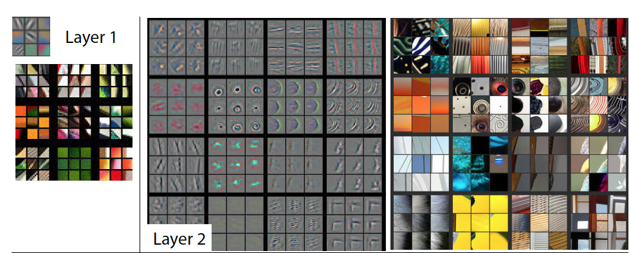
Visualizing Learned Filters
Figure Credit: [Zeiler & Fergus ECCV14]

Slide 54
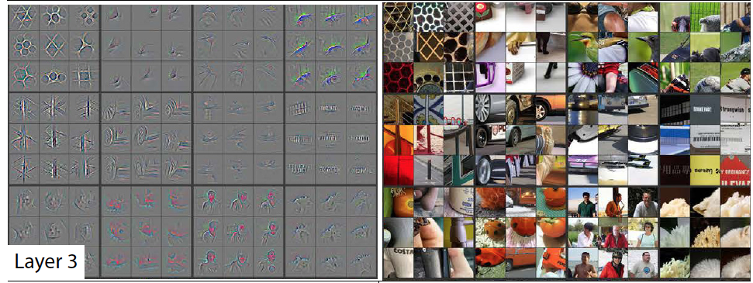
Visualizing Learned Filters
Figure Credit: [Zeiler & Fergus ECCV14]

Slide 55
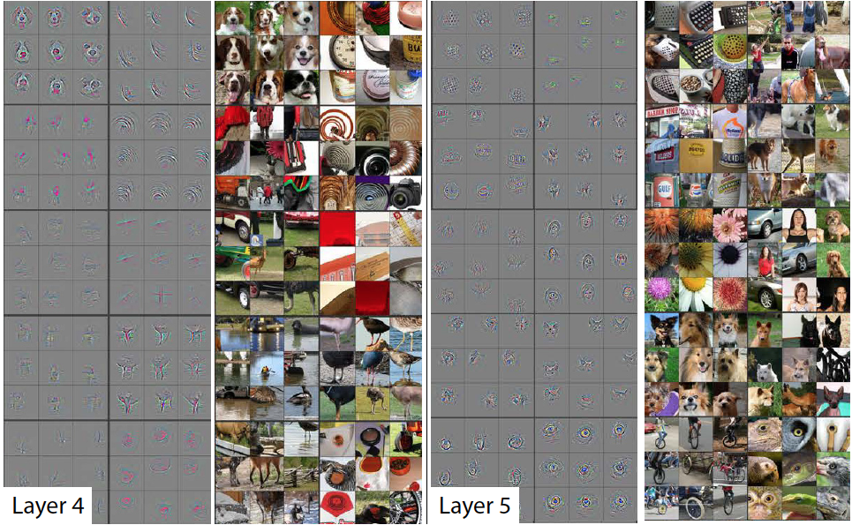
Visualizing Learned Filters
Figure Credit: [Zeiler & Fergus ECCV14]

Slide 56
two more layers to go: POOL/FC
Slide Credit: Fei-Fei Li, Justin Johnson, Serena Yeung, CS 231n
Notes:
Car image is photo taken by Lane McIntosh, permission to use.

Slide 57
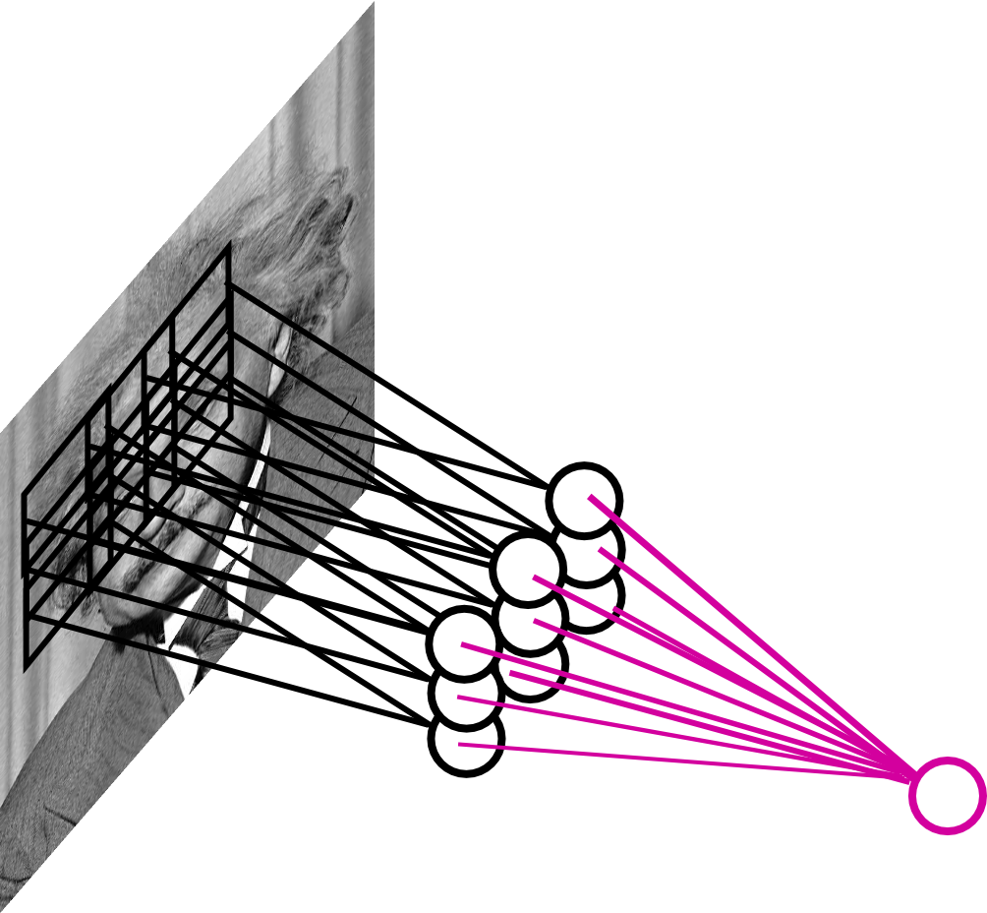
Pooling Layer
By “pooling” (e.g., taking max) filter
responses at different locations we gain robustness to the exact spatial location of features.
Slide Credit: Marc'Aurelio Ranzato

Slide 58
MAX POOLING
Single depth slice
1 | 1 | 2 | 4
5 | 6 | 7 | 8
3 | 2 | 1 | 0
1 | 2 | 3 | 4
dim 1
max pool with 2x2 filters and stride 2
6 | 8
3 | 4
dim 2
Slide Credit: Fei-Fei Li, Justin Johnson, Serena Yeung, CS 231n

Slide 59
Fully Connected Layer (FC layer)
Contains neurons that connect to the entire input volume, as in ordinary Neural Networks
Slide Credit: Fei-Fei Li, Justin Johnson, Serena Yeung, CS 231n
Notes:
Car image is photo taken by Lane McIntosh, permission to use.

Slide 60
Fully Connected Layer
Example: 200x200 image
40K hidden units
~2B parameters!!!
- Spatial correlation is local
- Waste of resources + we have not enough training samples anyway..
Slide Credit: Marc'Aurelio Ranzato

Slide 61
Fully Connected Layer
Each neuron looks at the full input volume
32x32x3 image -> stretch to 3072 x 1
input
activation
1
1
3072
10 x 3072
weights
10
1 number:
the result of taking a dot product between a row of W and the input (a 3072-dimensional dot product)
Slide Credit: Fei-Fei Li, Justin Johnson, Serena Yeung, CS 231n
Notes:
Preserve spatial structure of input

Slide 62
CNNs for Image Processing

Slide 63
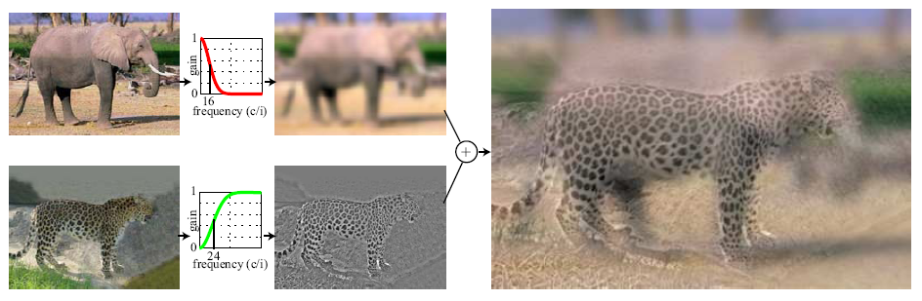
Hybrid Images
A. Oliva, A. Torralba, P.G. Schyns, “Hybrid Images,” SIGGRAPH 2006

Slide 64
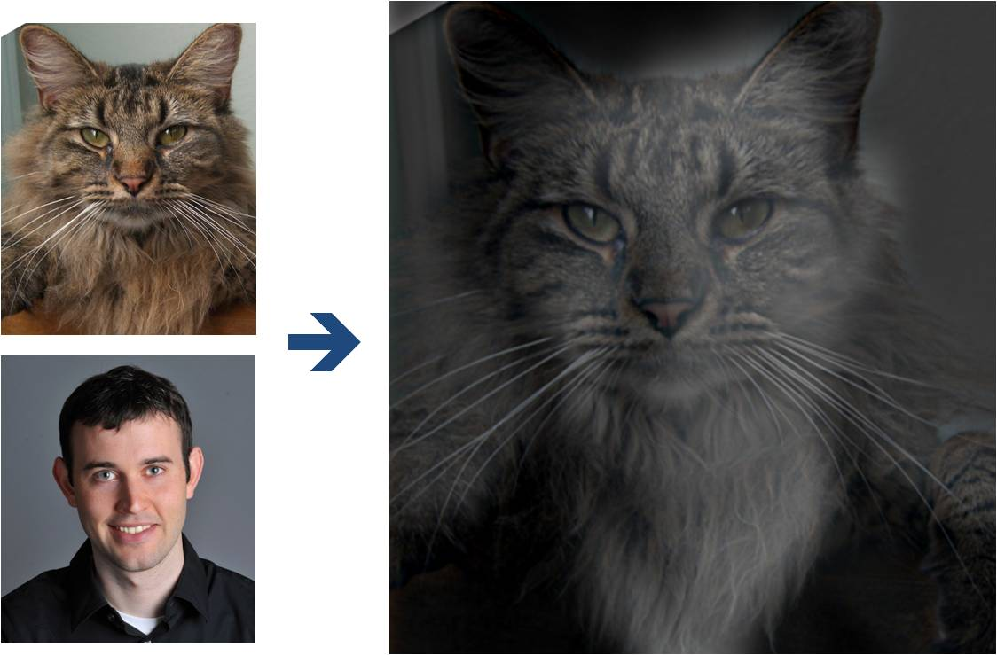
Why do we get different, distance-dependent interpretations of hybrid images?
?
Slide: Hoiem

Slide 65
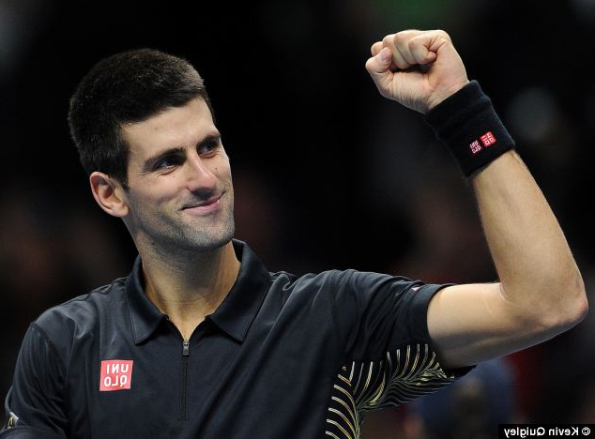
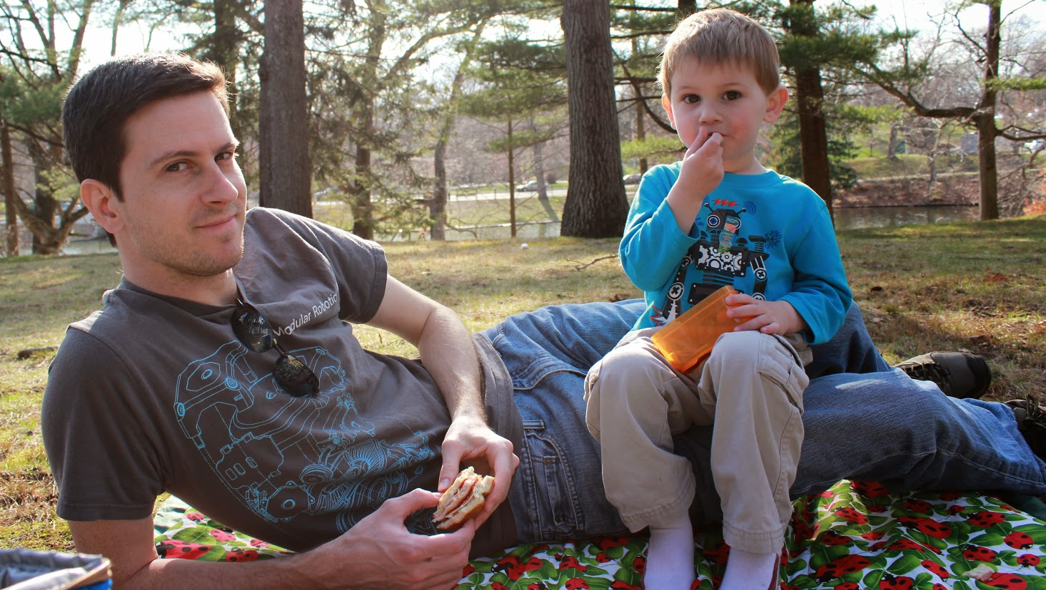

Slide 66
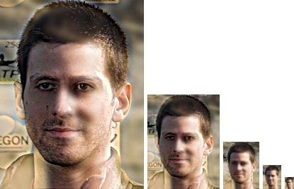

Slide 67
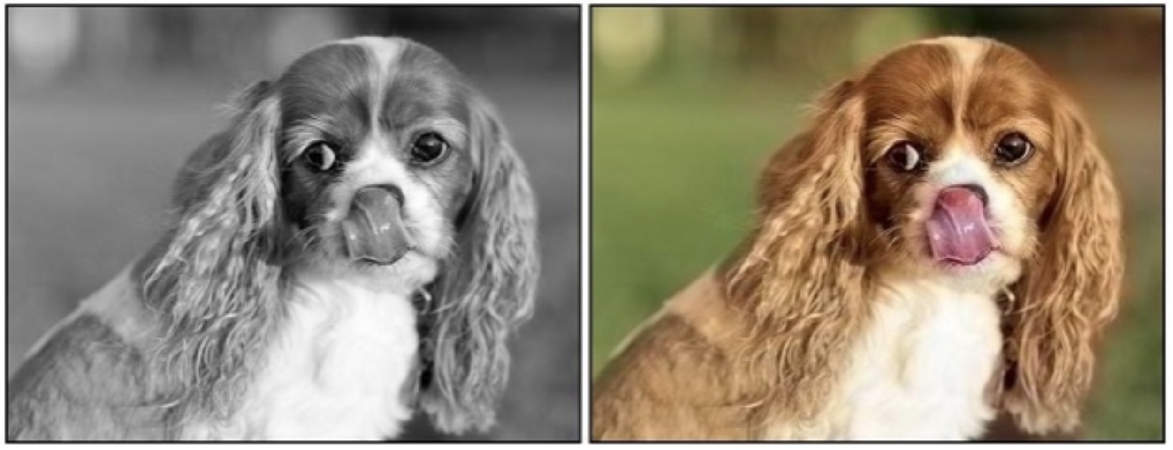

Colorization
Given a grayscale image, colorize the image realistically
Zhang et al. pose colorization as classification task and use class-rebalancing to improve results
Demonstrate higher rates of fooling humans using “colorization Turing test”
Colorful Image Colorization. Richard Zhang, Phillip Isola, Alexei A. Efros. ECCV 2016.

Slide 68

Colorization
Training data: decompose any RGB image into L*a*b color space
L: grayscale input (lightness channel)
ab: color channels
Train CNN with one million color images and a new objective function to incorporate more diverse colors. Many possible correct colorizations!
Colorful Image Colorization. Richard Zhang, Phillip Isola, Alexei A. Efros. ECCV 2016.

Slide 69


How to convert the inferred distribution to an image?
313-way classification over discretized ab color bins
Network will output a distribution z over colors at each pixel. Need to convert to a single pixel value
Mode: vibrant but sometimes spatially inconsistent (e.g., the red splotches on the bus)
Mean: produces spatially consistent but desaturated results, exhibiting an unnatural sepia tone

Slide 70
DeOldify
https://github.com/jantic/DeOldify

Slide 71


Super-Resolution
Low resolution
High resolution

Slide 72


Super-Resolution as a task
Quality-degrading factors / sources of noise:
Camera shake, shadows, motion blur, radial distortion from fisheye/GoPro type cameras, poor contrast, poor lighting, lossy compression, transmission defects, dust, haze, smoke, and mist, motion of the camera sensor platform, moving objects captured within the observed scene, e.g. people and vehicles.
How to measure super-resolution?
Peak signal-to-noise ratio (PSNR), higher is better. Relies upon the Mean Square Error (MSE) error metric to evaluate image compression quality between two images:

Slide 73

An early CNN paper (2016)
Dong, Chao, et al. "Learning a deep convolutional network for image super-resolution." European conference on computer vision. Springer, Cham, 2014.

Slide 74

An early CNN paper (2016)
Upscaling factor of 3 !
Dong, Chao, et al. "Learning a deep convolutional network for image super-resolution." European conference on computer vision. Springer, Cham, 2014.

Slide 75


Underexposed Photo Enhancement
Goal: enhance extreme low-light imaging with severely limited illumination (e.g., moonlight) and short exposure (exposure time is set to 1/30 second)
The less light there is, the more ISO you need
High ISO can be used to increase brightness, but amplifies noise
Leads to low signal-to-noise ratio (SNR) due to low photon counts
Learning to See in the Dark. Qifeng Chen, Vladlen Koltun. CVPR 2018.

Slide 76

Solution? Collect dataset and train a deep network
See-in-the-Dark (SID) dataset contains 5094 raw short exposure images, each with a corresponding long-exposure reference image
Corresponding reference (ground truth) images captured with 100-300x longer exposure (i.e. 10 to 30 seconds)
Overcome low photon counts!
Train deep neural networks to learn the image processing pipeline w/ L1 loss.
Learning to See in the Dark. Qifeng Chen, Vladlen Koltun. CVPR 2018.

Slide 77

Underexposed Photo Enhancement
Learn image-to-image mapping? Too hard!
Instead estimate an image-to-illumination mapping (model varying-lighting conditions)
Illumination maps for natural images typically have relatively simple forms with known priors
Then take illumination map to light up the underexposed photo.
Minimize (reconstruction loss + smoothness loss + color loss)
Underexposed Photo Enhancement Using Deep Illumination Estimation. Wang et al. CVPR 2019.

Slide 78




Image Inpainting
Perceptual loss is added to ELBO, the typical objective function used in variational autoencoders, to increase the sharpness and overall quality of inpainted images
Demonstrate results on attribute-guided image completion
input
not smiling
smiling
ground truth
: generated image
: ground truth image
: activation of the l^{th} layer of a pre-trained VGG
Variational Image Inpainting. Cusuh Ham*, Amit Raj*, Vincent Cartillier*, Irfan Essa. NeuRIPS 2018 Workshop.

Slide 79

Image Inpainting
Proposes partial convolutions, comprised of a masked & re-normalized convolution operator
Updates mask automatically after partial convolutions, removing any masking where partial convolution was able to operate on unmasked value
Image Inpainting for Irregular Holes Using Partial Convolutions. Liu et al. ECCV 2018.

